Slide 1

Group 5 -
Sprint Cycle 4

Slide 2
Team members
1.Brian Le (Bao Le) - Frontend Developer
-Tested for view confirmation of appointment of customer side
- Tested cancel appointment of customer side - users actors
3.G (Guillermo Clara) - Full-Stack Developer
Implemented final page design. Restructured all front end files. Added responsiveness, organized the CSS code. Finished implementing connection between frontend and backend
5.Jisoo Park - Backend Developer
- Implementing password recovery system
- Tested front-end back-end connectivity and functionality (especially with POST request)
- Helped with managing assignment documents
2.Aleeza Iftikhar- Frontend Developer
Tested functionality of business dashboard pages. (e.g. adding / removing employees and services). Communicated about password recovery bug and hiding django key with backend team.
4. Jennie Vu (Nga Vu) - Frontend Developer
- Tested front-end web pages for customer users and business access users. Find bug and discuss with team
- Tested multiple appointments making on the View Appointment page.
- Tested new business owner user access (create new profile, manage employees/services). Tested manage scheduled appointments on the business owner access site.

Slide 3
Project Backlog SC 4
Make the website responsive – Done
Finish implementing authentication that require owner access – Done
Improve the CSS of the project by organising the website better – Done
Implementing mechanisms to fetch data from the backend into other pages – Done
Make message pop up to display errors – Done
Password recovery system – Done

Slide 4
Project Testing SC 4
List your business – Pass
Edit employees – Pass
Edit Services - Pass
Make appointment - Pass
View confirmation of the appointment - Pass
Cancel appointment - Pass
Search Salon – Pass
Manage Business Information (Description, User Info) – Pass
Appointment filtering
Appointments section
Password Recovery – Pass

Slide 5
Challenges & Lessons Learned
Challenges:
Difficulty with finding a way to code together in real time
Lessons Learned
It is better to code with the same IDE and or with screen share

Slide 6
Project Testing SC 4
Discuss the pricing of our premium accounts
Add missing elements that were found
Polishing some details in the website
Continue testing functions of our webpage and fine tuning our code
Add documentation and explanation of code functionality

Slide 7
Version Control
https://github.com/Team5SWE/Petit
Figma Design
https://www.figma.com/file/CW5JgxFRnSAnc1pMCdYW66/Petit-Design?node-id=0%3A1

Slide 8
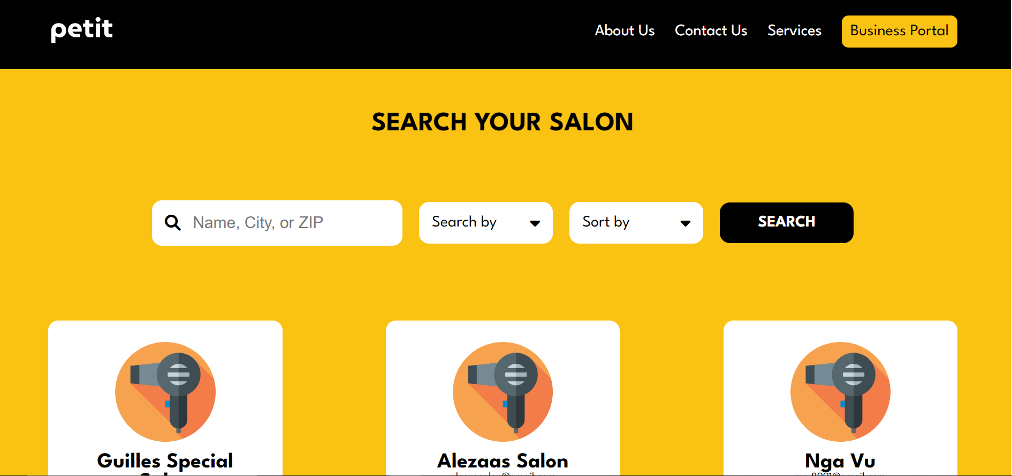
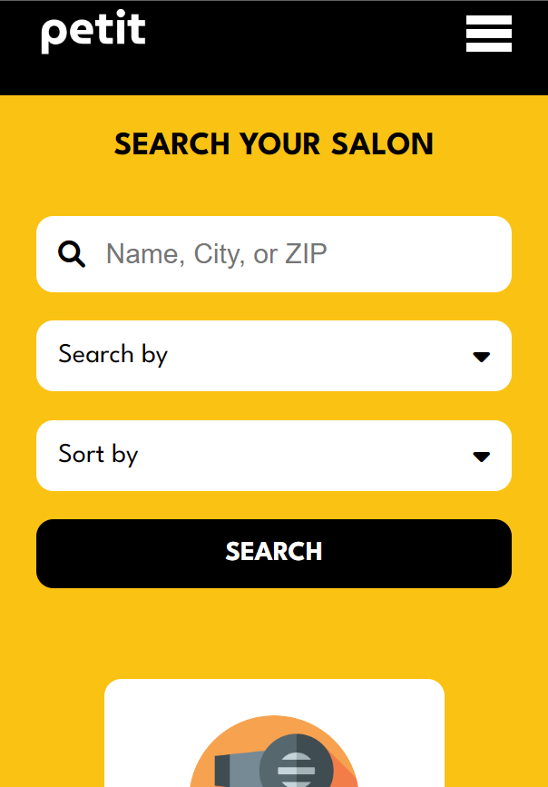
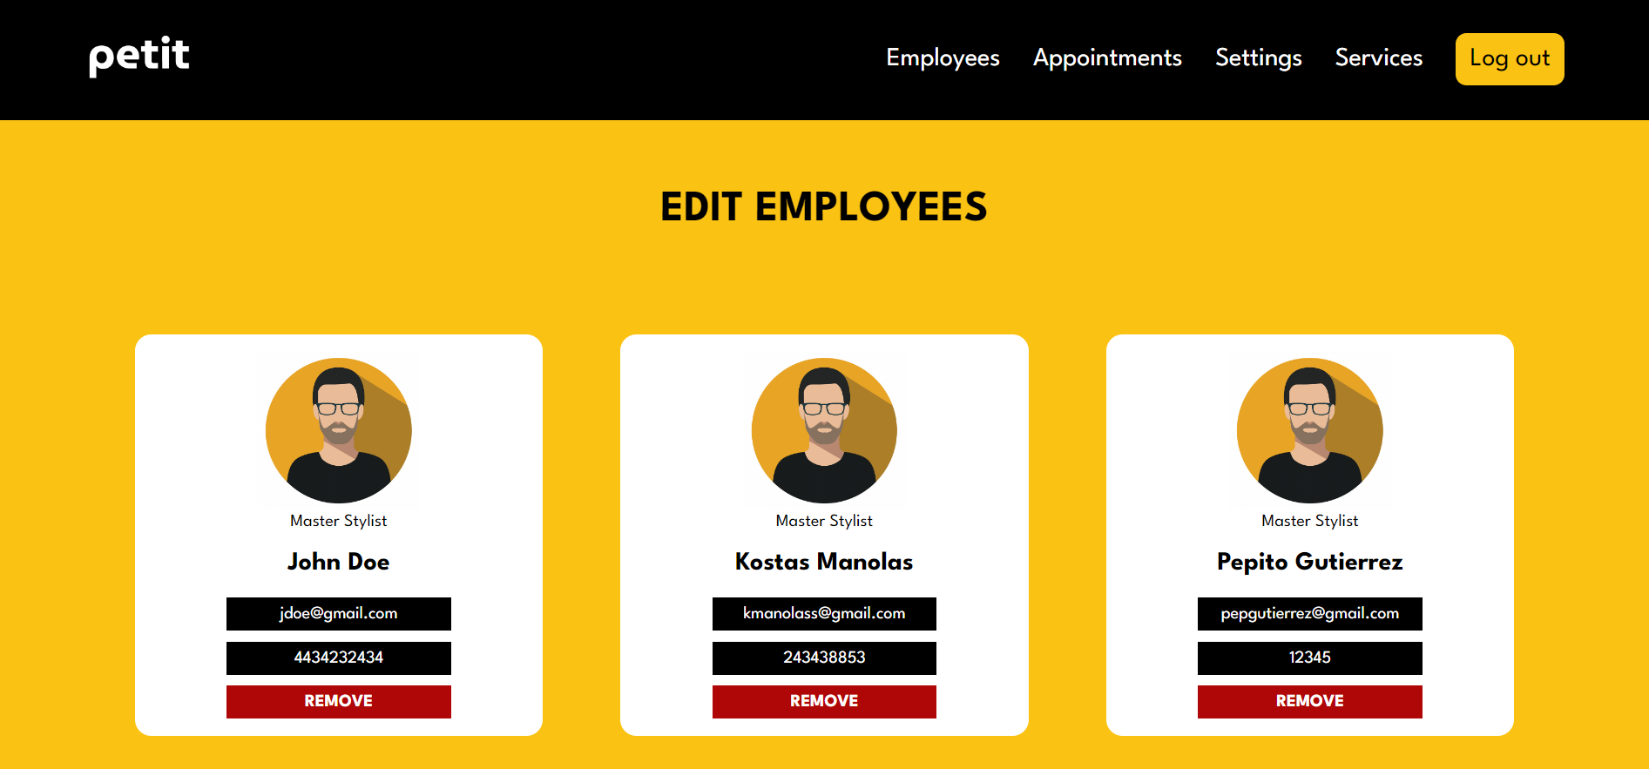
Responsive
New Responsive Search Salon Page
Website

